Slide 1
GreenTrack
It’s almost like this is what blockchain was made for

Slide 2

Our Objective
Develop a blockchain-based system to provide transparent and effecient produce traceability.
Our main emphasis is on creating a data sharing platform that ensures visibility and trust

Slide 3
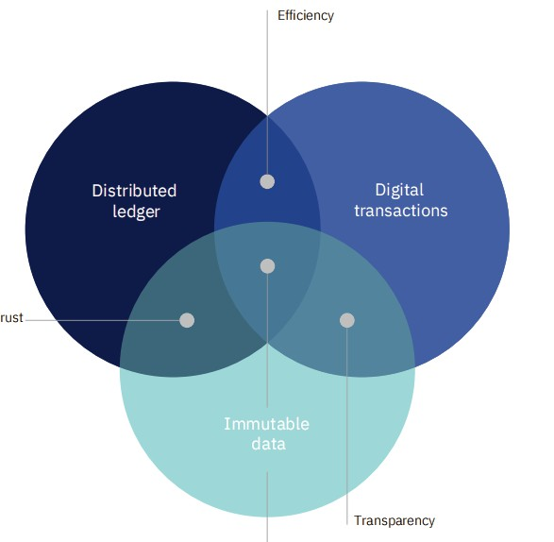
Source: IBM Food Trust Case Study

Slide 4

Problem Statement
The main problem in the supply chain currently is lack of transparecy.
Most records are still paper based, creating inefficiencies and opportunities for fraud

Slide 5



The Solution
A decentralized and indepedent data sharing platform
Data is immutable once entered into the
blockchain
Once data is shared every stake holder has immediate access.

Slide 6
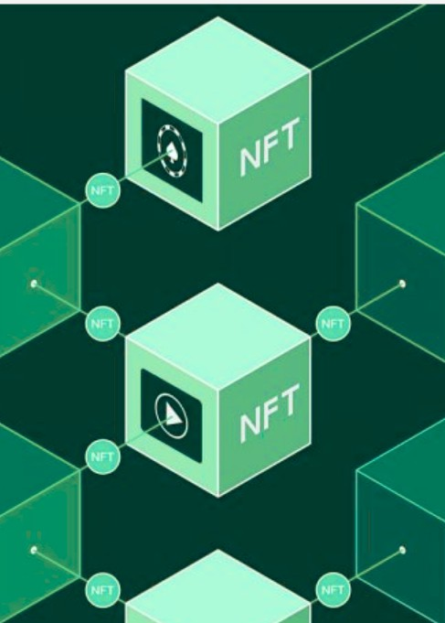


Example Use Case
A manager at Foodmartt receives a complaint that some Brocolli they sold was had already gone bad. The manager is supossed to solve this as soon as possible. Formetl, they would have to make several calls to get to know provenance and deal with issue. But now with this data sharing platform its a easy as ABC or unlcoking your phone

Slide 7


System Flow
Farmer Registration & Listing
Buyer Browsing & Order Placement On-Chain Payment Processing Logistics & Delivery Tracking
Buyer Verification & Finalization Dispute Resolution (If Needed)
Record Keeping and Viewing(Main Issue)

Slide 8

We add value to the ecosystem
Improve brand trust and strenghten customer loyalty, grow revenue
Reduce food wastage
Conduct targetted recalls
For logistics companies, they can manage inventories near real time.

Slide 9
Challenges
Blockchain adoption might be a challenge to common users. Developing a secure blockchain-based system requires investment , User training & technical support, Blockchain
infrastructure
Regulatory & Legal Challenges
The Central Bank of Kenya (CBK) has warned against crypto transactions, though no clear ban exists
Compliance with Food & Trade Laws - Compliance with AFA and KEBS
Data Privacy & Security

Slide 10
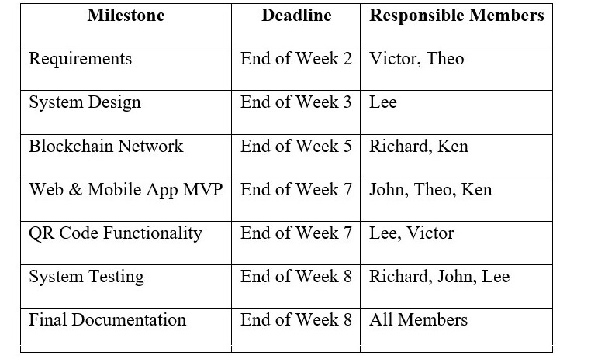
Roadmap

Slide 11
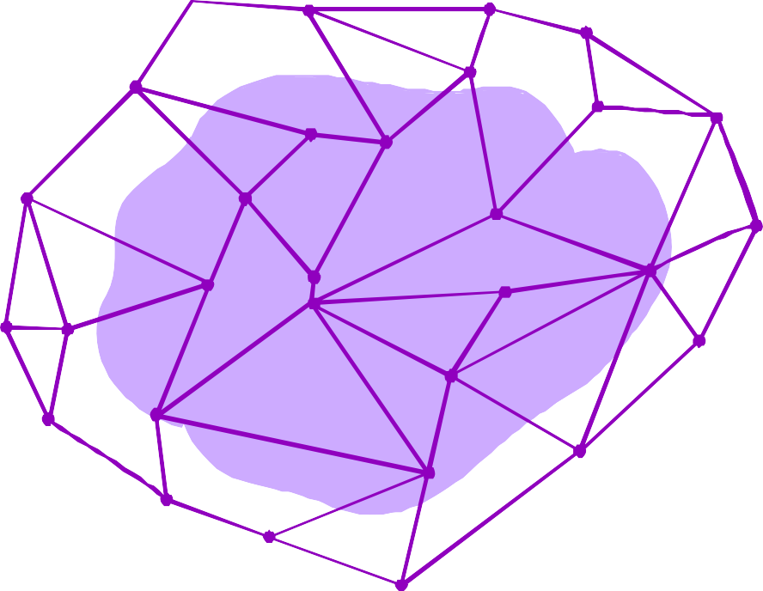
Thanks!

